Slide 1
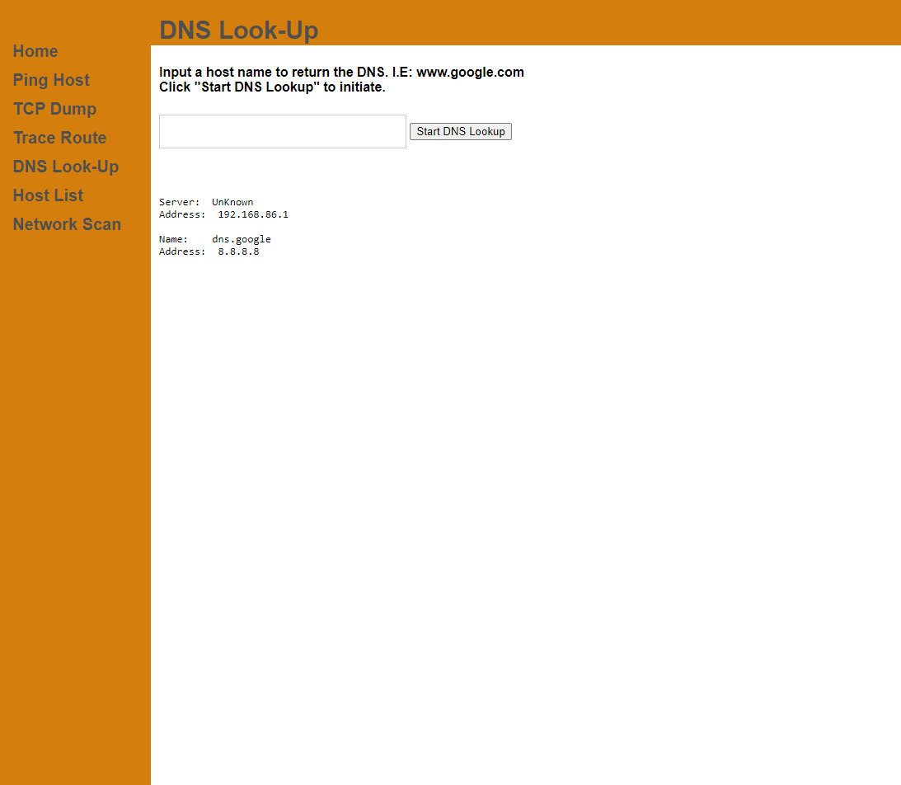
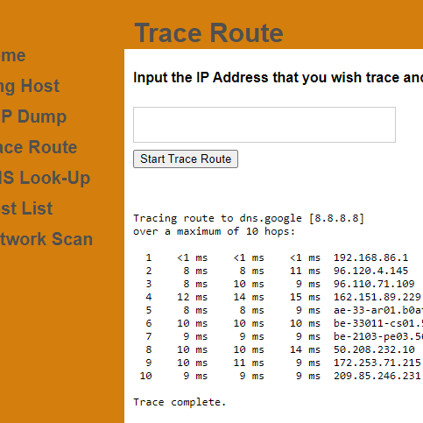

Web Interface: Basic Networking
Basic networking tools are a must for any solid IT department.
Identify network vulnerabilities
Control network access
Project Coder: Daniel Hopps
GitHub Repository

